Slide 1
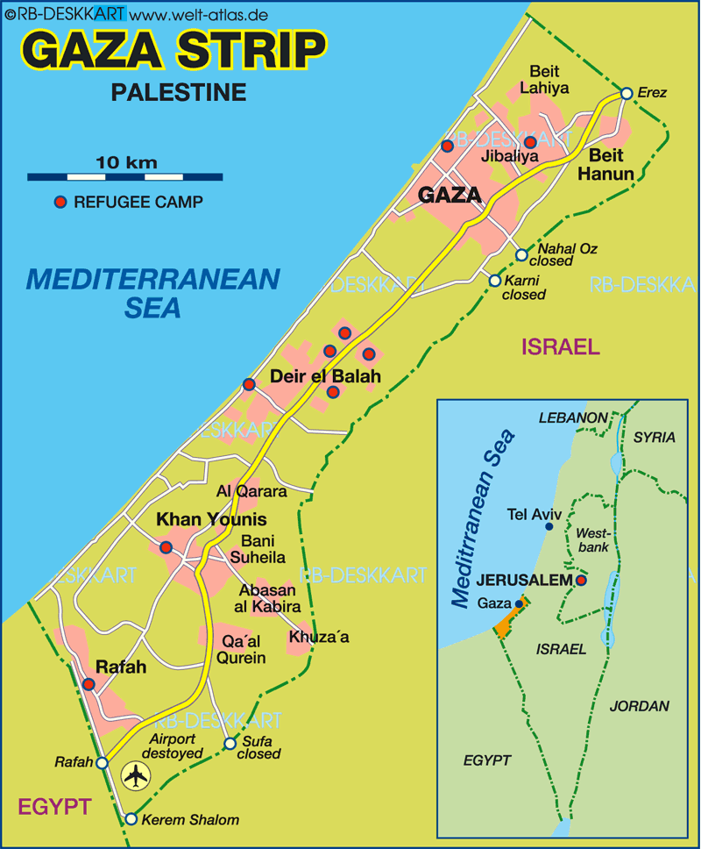
Situation of Gaza Strip dealing with COVID-19 crisis

Slide 2
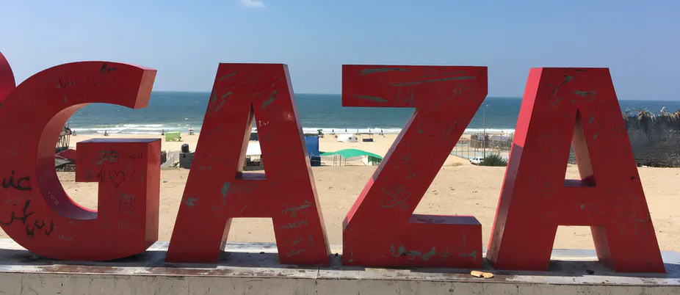
Housing 2 million Palestinians in only 365 km2 area of land, the Gaza Strip is considered to be one of the most densely populated urban areas around the world with nearly 5,479 persons per square. Adding to that it is besieged since more than 10 years.

Slide 3
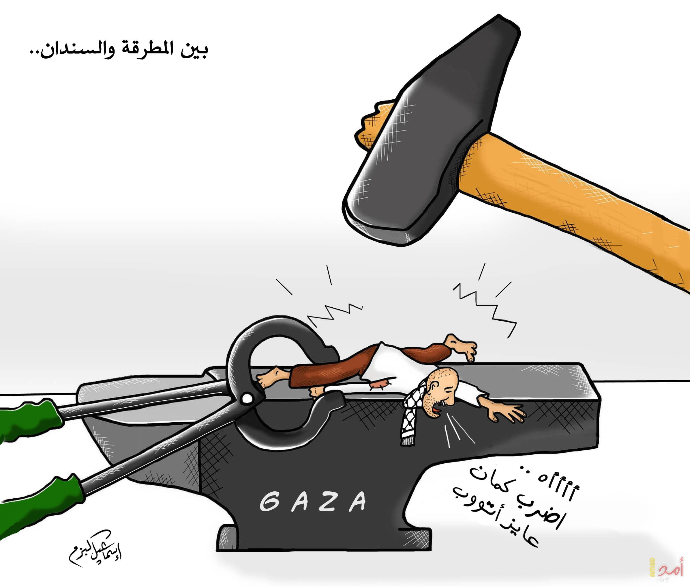
The Palestinians in Gaza were fighting the Israeli occupation and the COVID-19 pandemic.
This reality raises questions about the role of these factors in advancing social collapse in Gaza, and the impact of the pandemic on vulnerable groups in Gaza.
The socioeconomic crises that are amassing as a result of Israel’s ongoing closure and blockade on Gaza have only been made more profound by the Coronavirus outbreak.
Coronavirus

Slide 4
Some of the devastating impacts:
The Israeli regime restricted the import of medical test kits into Palestinian territories.
Absence/shortage of food and non-food items and supplies
Social inequalities have increased, while the marginalized and disadvantaged in society no longer have rights and live in limbo.
Limited access to water affects handwashing, and raises the risk of disease, particularly for children, which is especially dangerous in densely populated areas like Gaza.

Slide 5
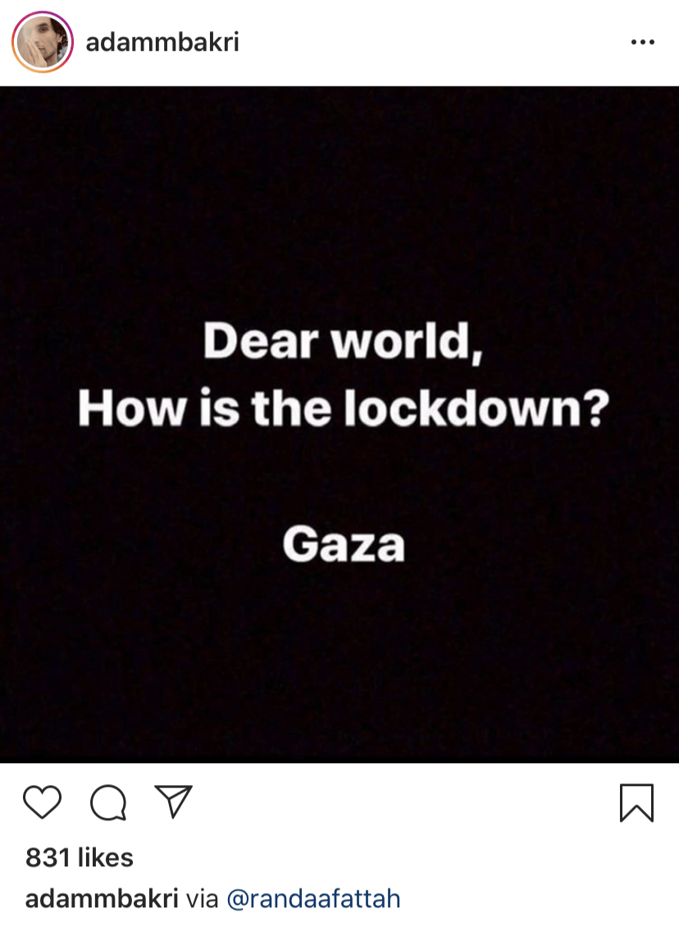
More than 56% of the Gazans were living under poverty line before the pandemic. Now, it is expected to rise to be 64% in the Gaza Strip, while unemployments rates are 45%.
Lack of food security has become 68%, and 80% of families depend on food aids.
More than 45,000 workers have lost their job during the pandemic.
Simply put, Palestinians in Gaza are haunted by social misery, violence, and wars every second of their lives.

Slide 6
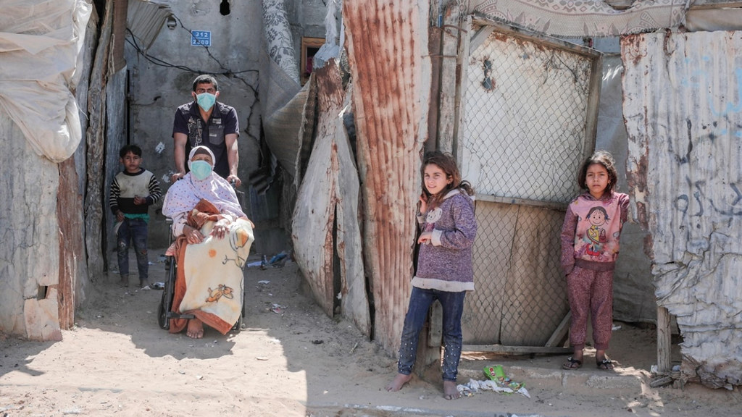
Insufficient attention is being paid to the unfolding COVID-19 crisis playing out in the Gaza Strip, according to a team of international experts.

Slide 7
The precautionary measures against the spread of the coronavirus have confined breadwinners to their homes, which means that the financial stability of more than half of Gaza’s population and their access to water are undermined. Jamil Abu al-Saud, a 35-year-old father of two children and a taxi driver from Deir al-Balah, said in his testimony to Al Mezan,
“These daily 16-hour electricity cuts have made it very hard for us to obtain water which is supplied to the neighborhood once every three days and lasts about two to three hours only. We can no longer store water in the roof tanks because water pressure in the pipes is weak and requires an electric pump.… In the past couple of days, we ran out of all stored water….”

Slide 8
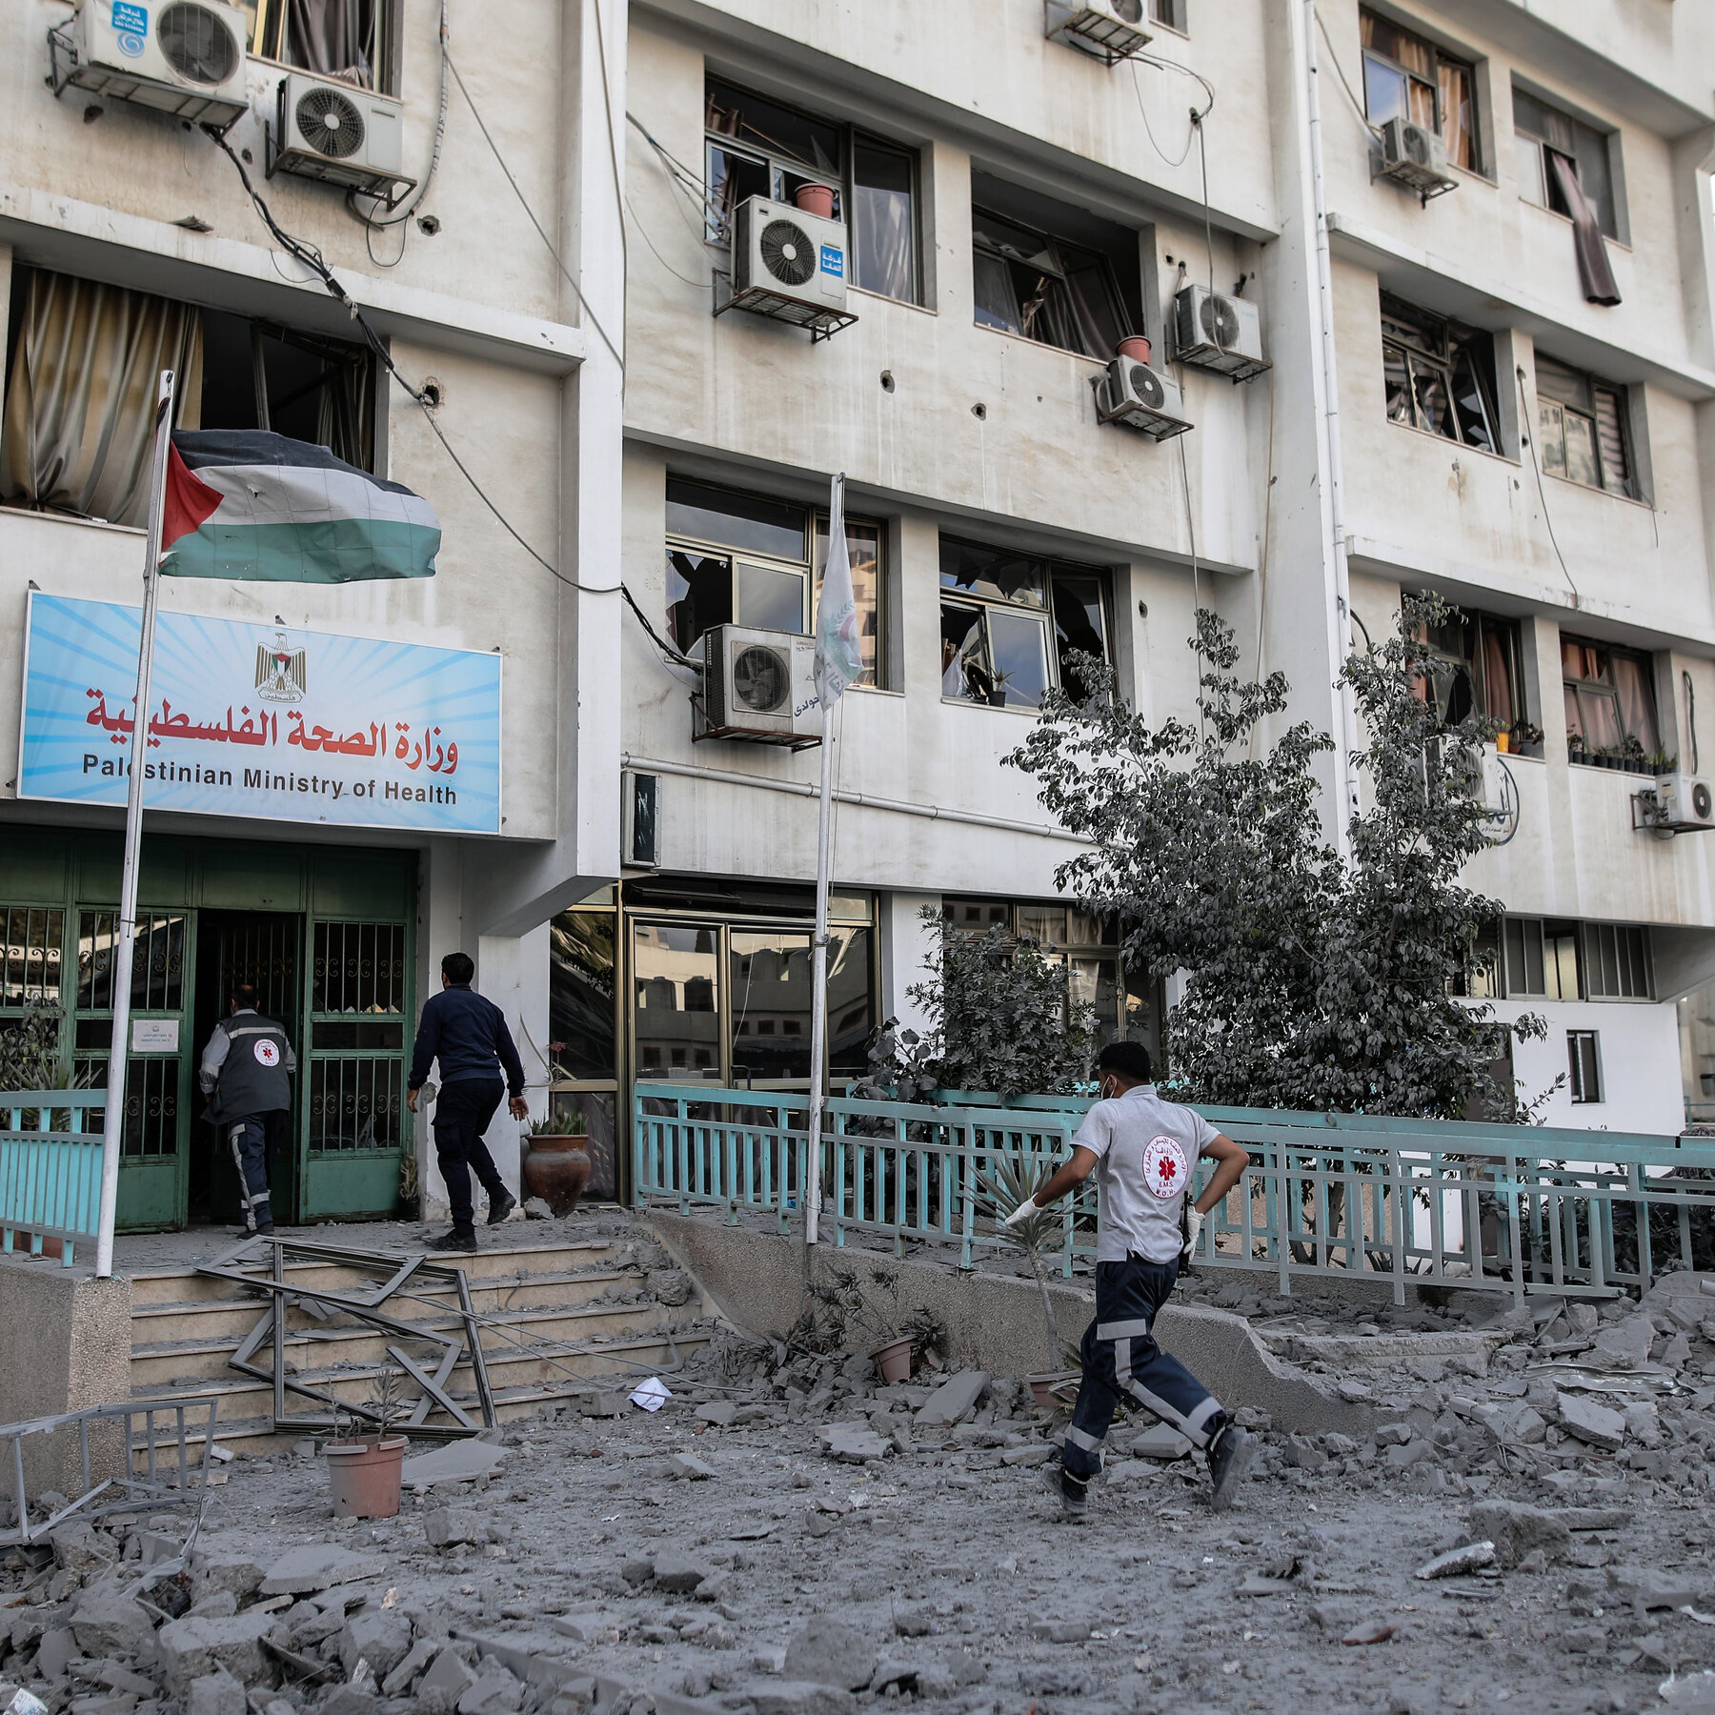
An Israeli airstrike hit the street, sending shrapnel into the clinic, shattering windows, shredding doors, furniture and computers — and wrecking Gaza’s most important coronavirus test laboratory.
“During times of war people need more treatment than usual,” Mohammed Abu Samaan, a senior administrator at the clinic, said Tuesday. “Now we can’t give people medicine.”

Slide 9
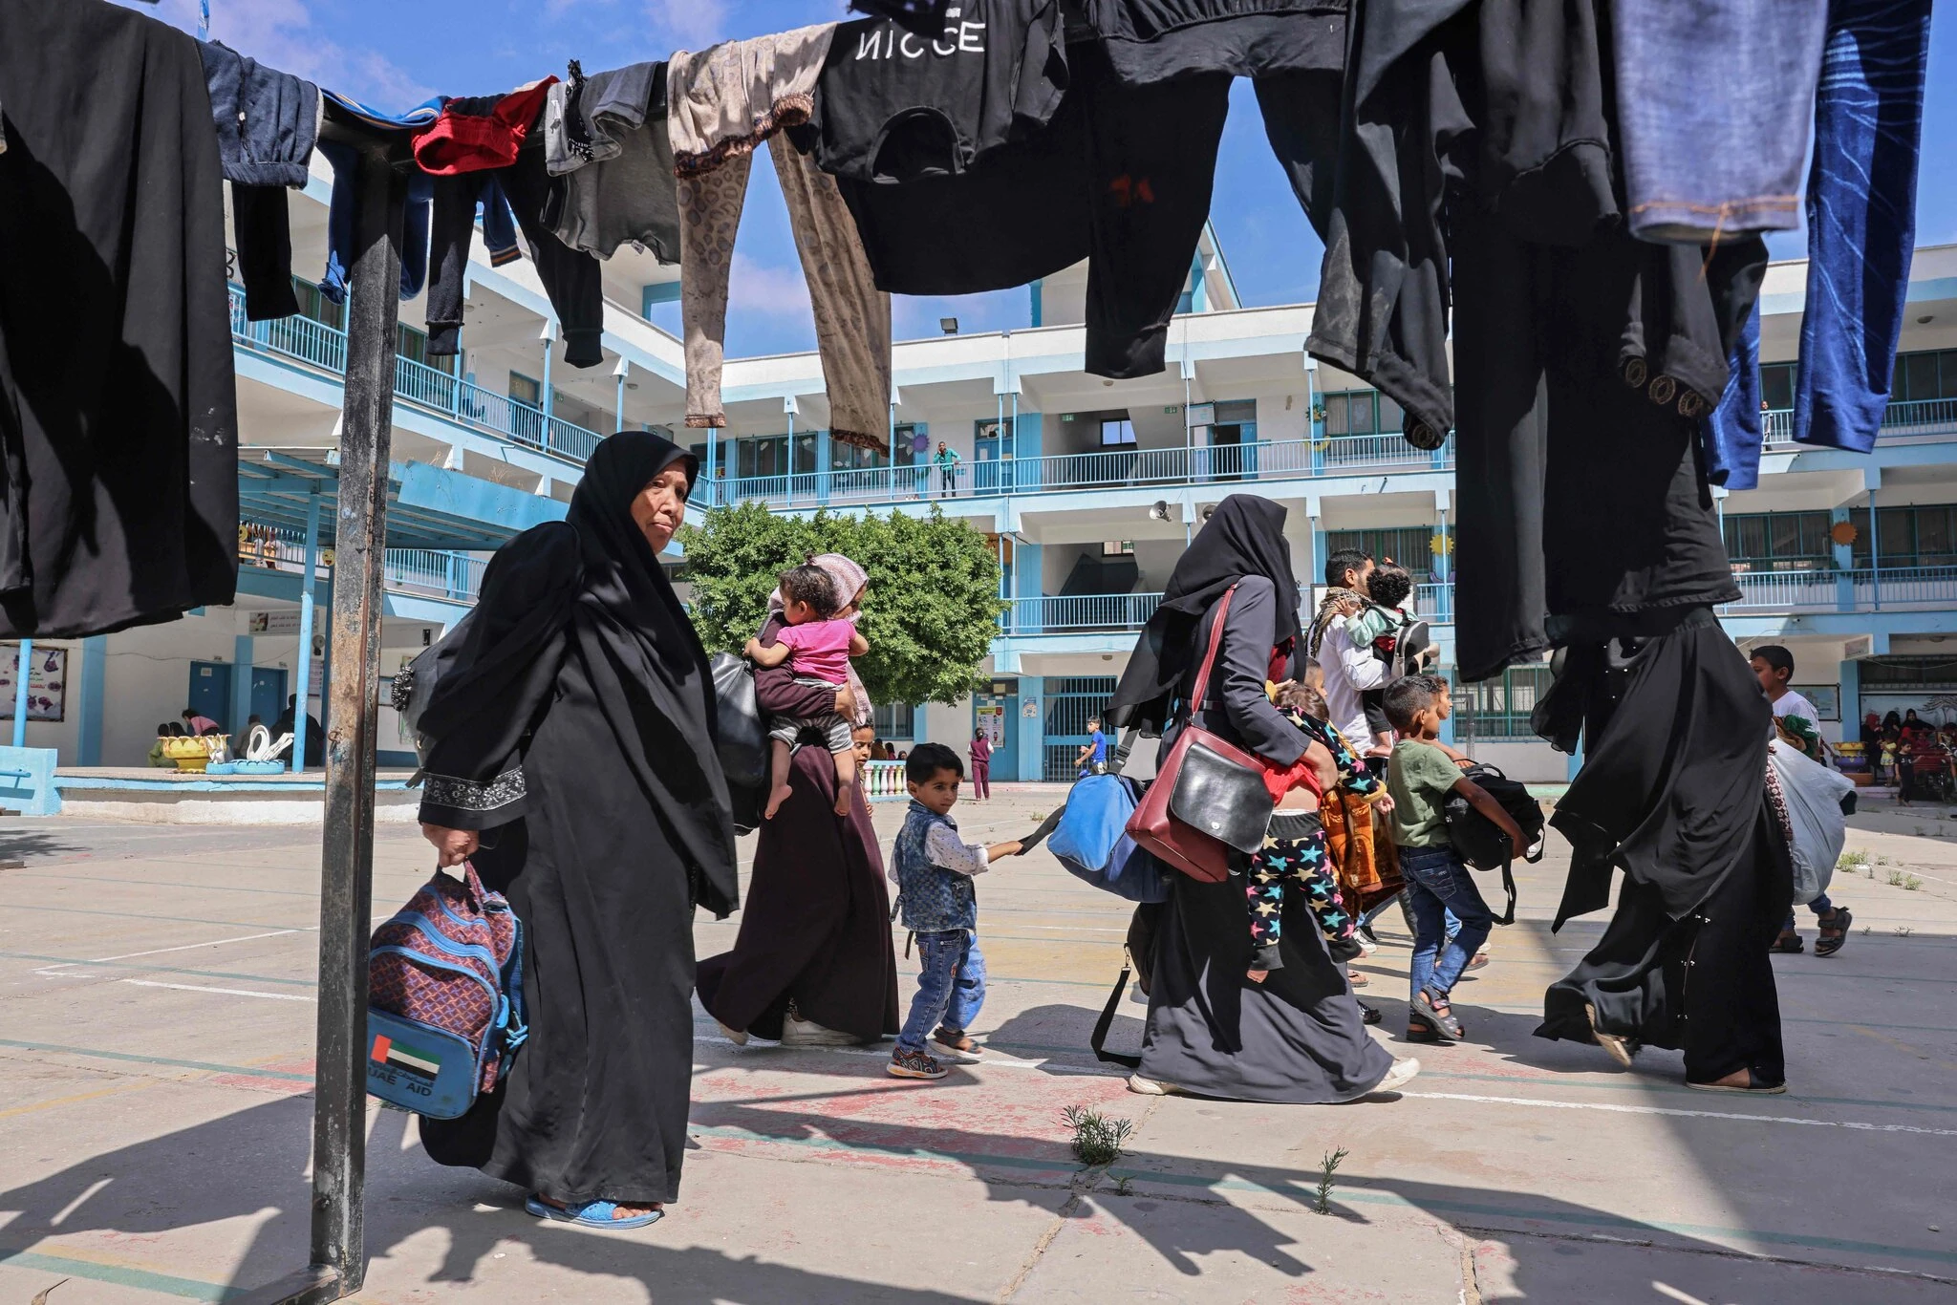

Slide 10
Call to Action
The Palestinian Authority and concerned agencies, NGOs and international bodies to mobilize support for residents of the Gaza Strip, whose lives are threatened by the unprecedented coronavirus outbreak, and to improve the living conditions in Gaza and support the Strip’s municipalities.
The international community to exert pressure on Israel, the occupying power, to immediately and unconditionally lift the blockade and closure and cease all punitive measures.

Slide 11
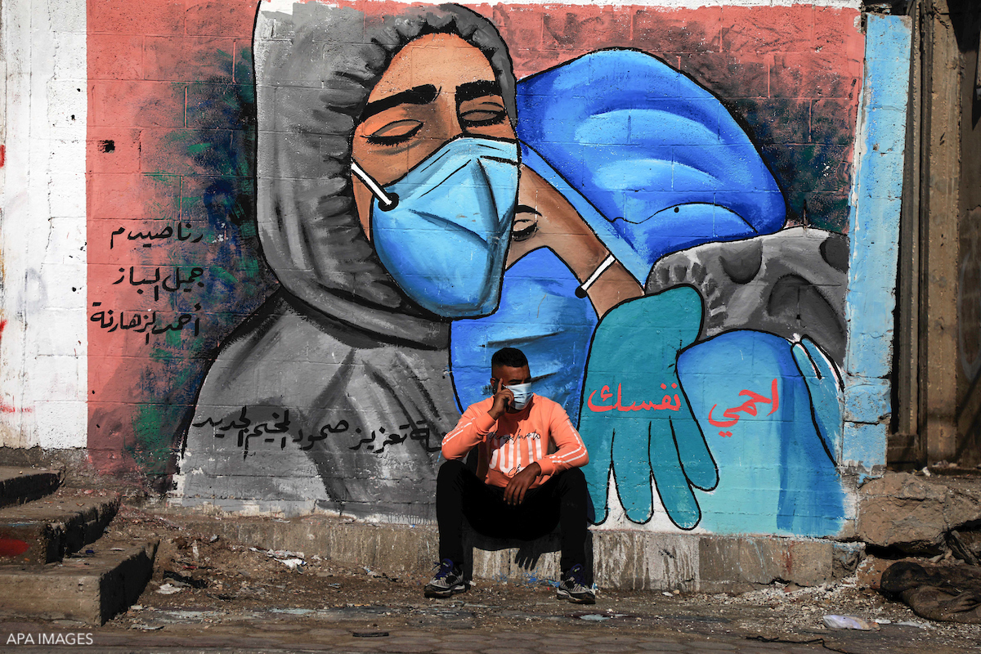

Slide 12
The Gaza Electricity Distribution Corporation (GEDC) to cooperate with the municipalities to ensure water supply that is more regular and efficient to households, and prioritize the provision of power supply to municipal wells and networks to better equip residents with the amounts and quality of water necessary to fight the COVID-19 outbreak

Slide 13
How else can we help?
The majority of the Palestinian organizations have adjusted their strategies to cope with the situation, providing the maximum support to the community in this difficult period.
Globally, a rising number of funding opportunities are being given to researchers and entrepreneurs to invest their intellectual abilities and innovation to find solutions and come up with studies about this pandemic. So, you know this now, it is your time to invest your capabilities and be innovative!

